Slide 1
CSE299 project
CSE299 final project progress

Slide 2
Members
Project Group member :
Member 1:
Name: Antu saha
Id:1722104642
Member 2:
Name:Ashdsin Huq
ID:1632482042

Slide 3
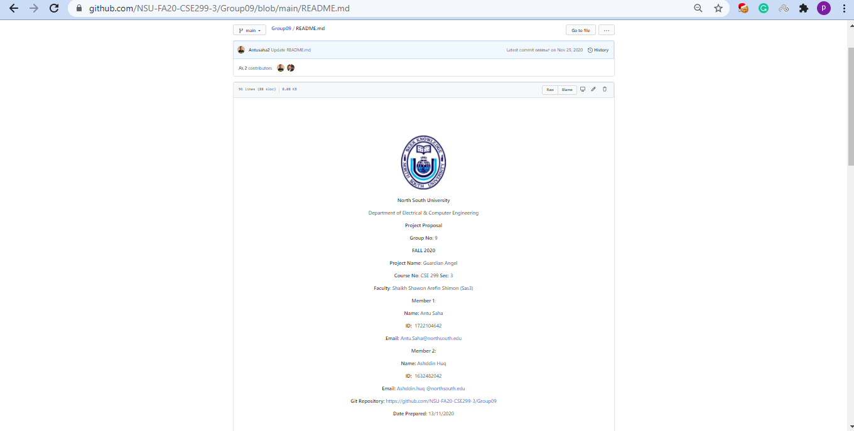
Project Readme

Slide 4
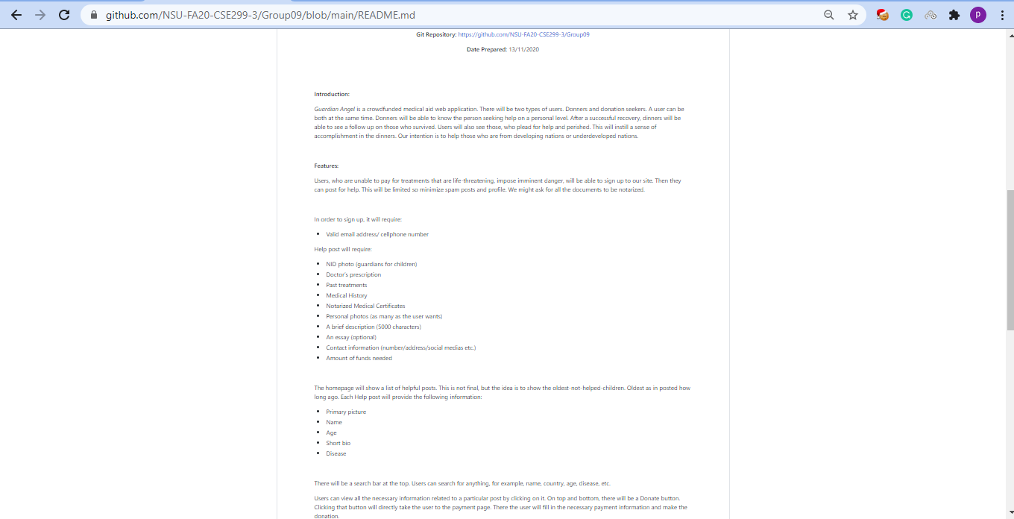
Project Readme(Cont.)

Slide 5
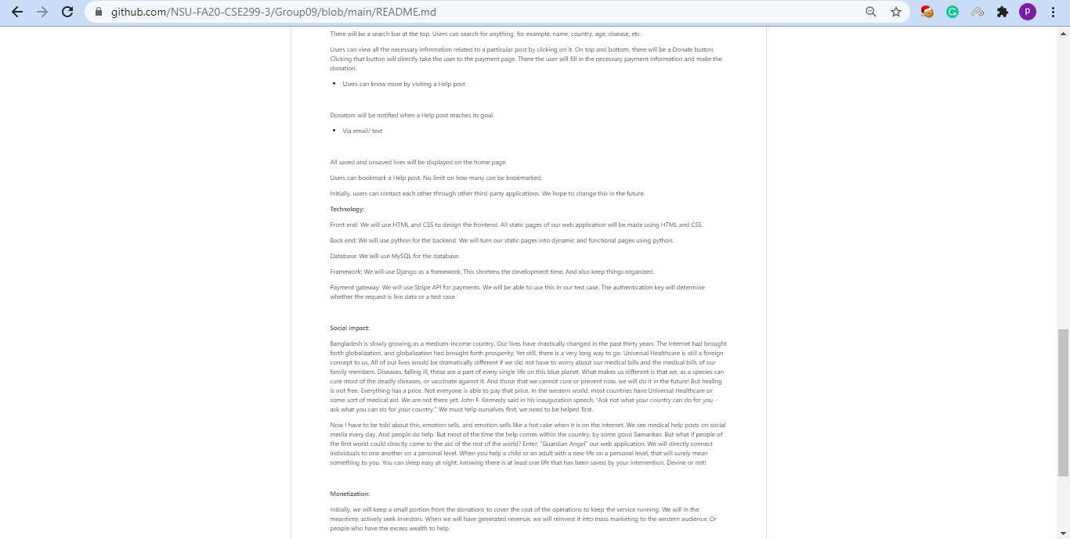
Project Readme(Cont.)

Slide 6
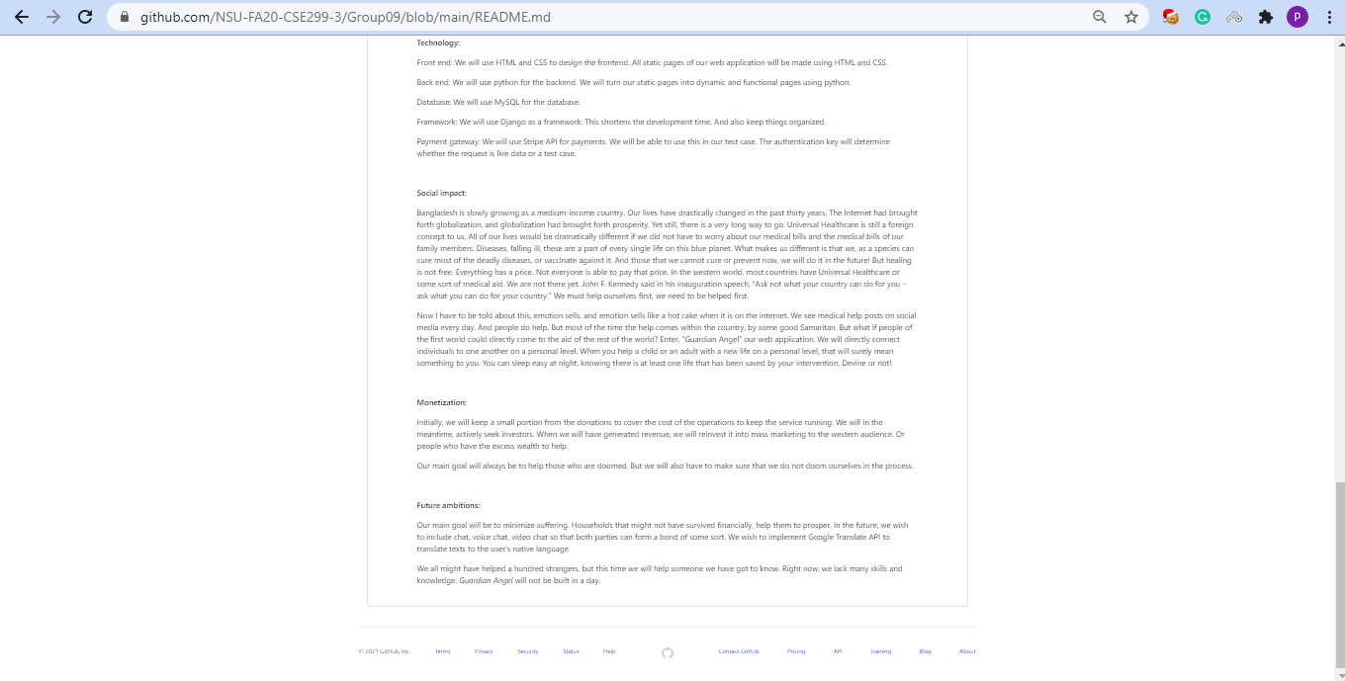
Project Readme(Cont.)

Slide 7
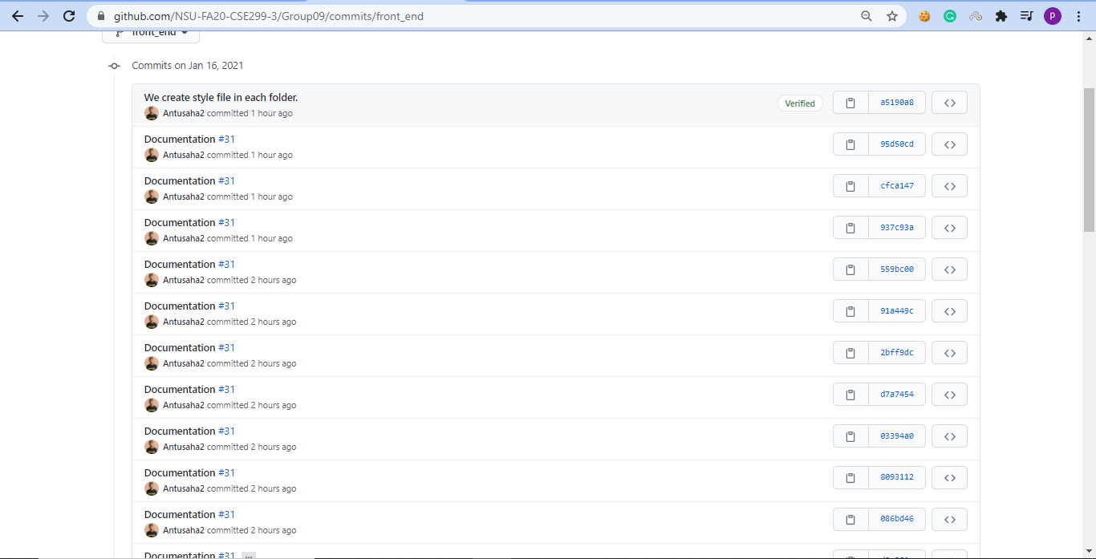
Commits

Slide 8
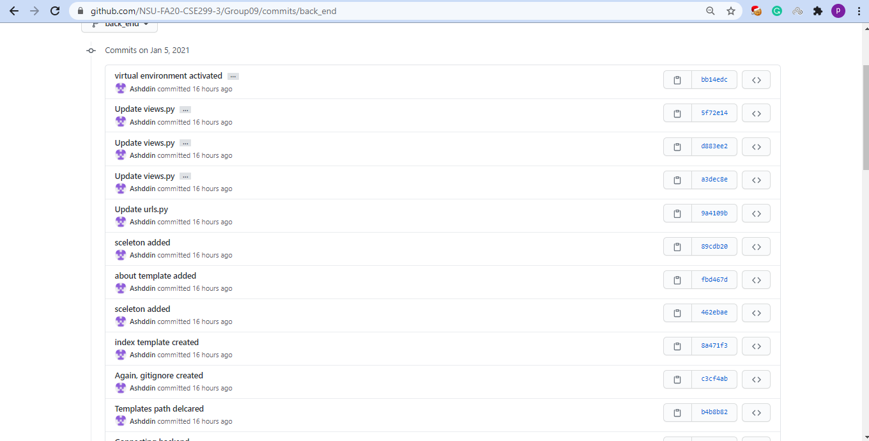
Commits(Cont.)

Slide 9
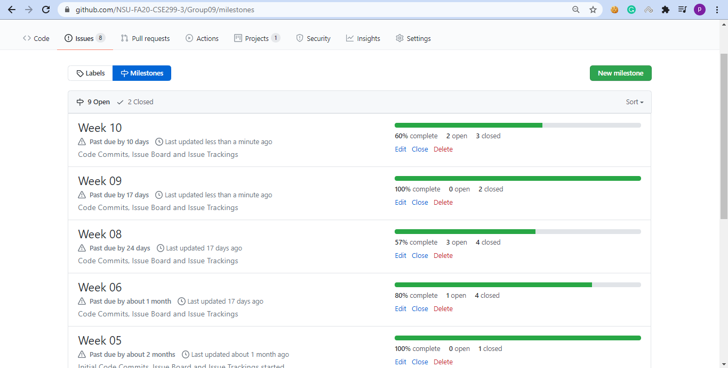
Issue board

Slide 10
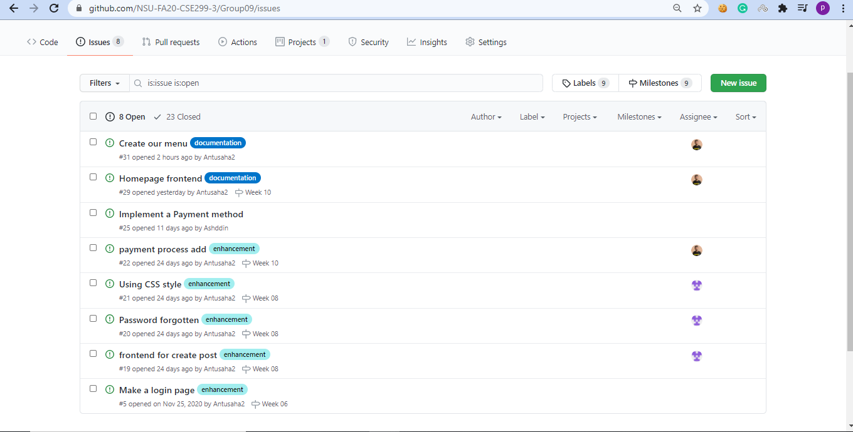
Issue board(Cont.)

Slide 11

Project UI

